Slide 1

Innovative Ways to Finance Your Solar Project
ASES Conference 2019
August 7, 2019
Brian Edstrom

Slide 2


So you need money. What do you offer investors in return?
Karma?
A tote bag?
“Free” energy?
Equity?
Interest on a loan?
Share of profits?

Slide 3
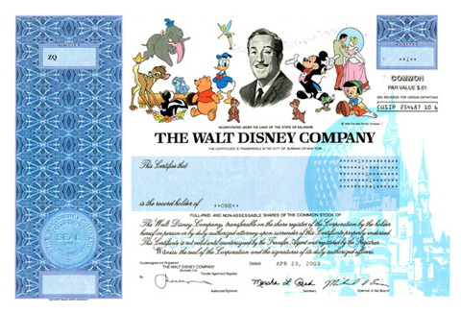
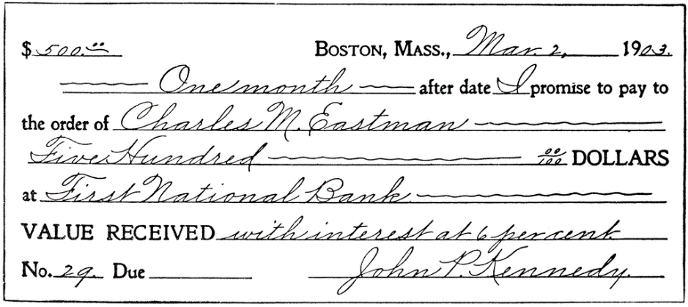
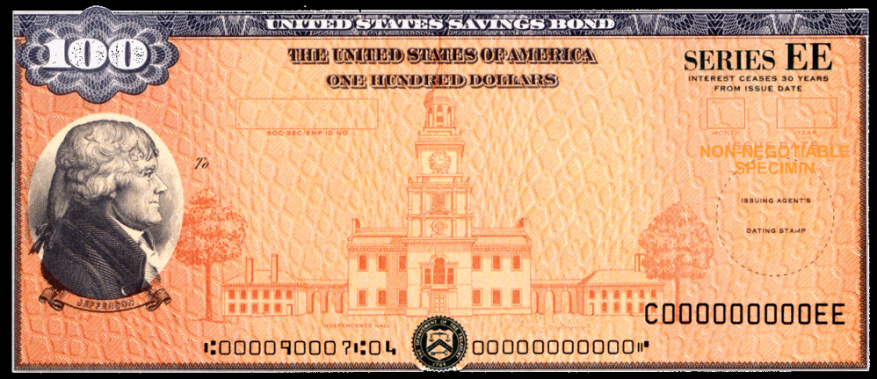
Financing 101: What is a Security?

Slide 4

Financing 101: What is a Security?
Investment Contract
Investment of Money
Common Enterprise
Expectation of Profits
Efforts of Others

Slide 5
Financing 101: Securities Regulations
General Rules:
Securities offerings must be registered (unless exempt)
No fraud
Disclosure, disclosure, disclosure!

Slide 6
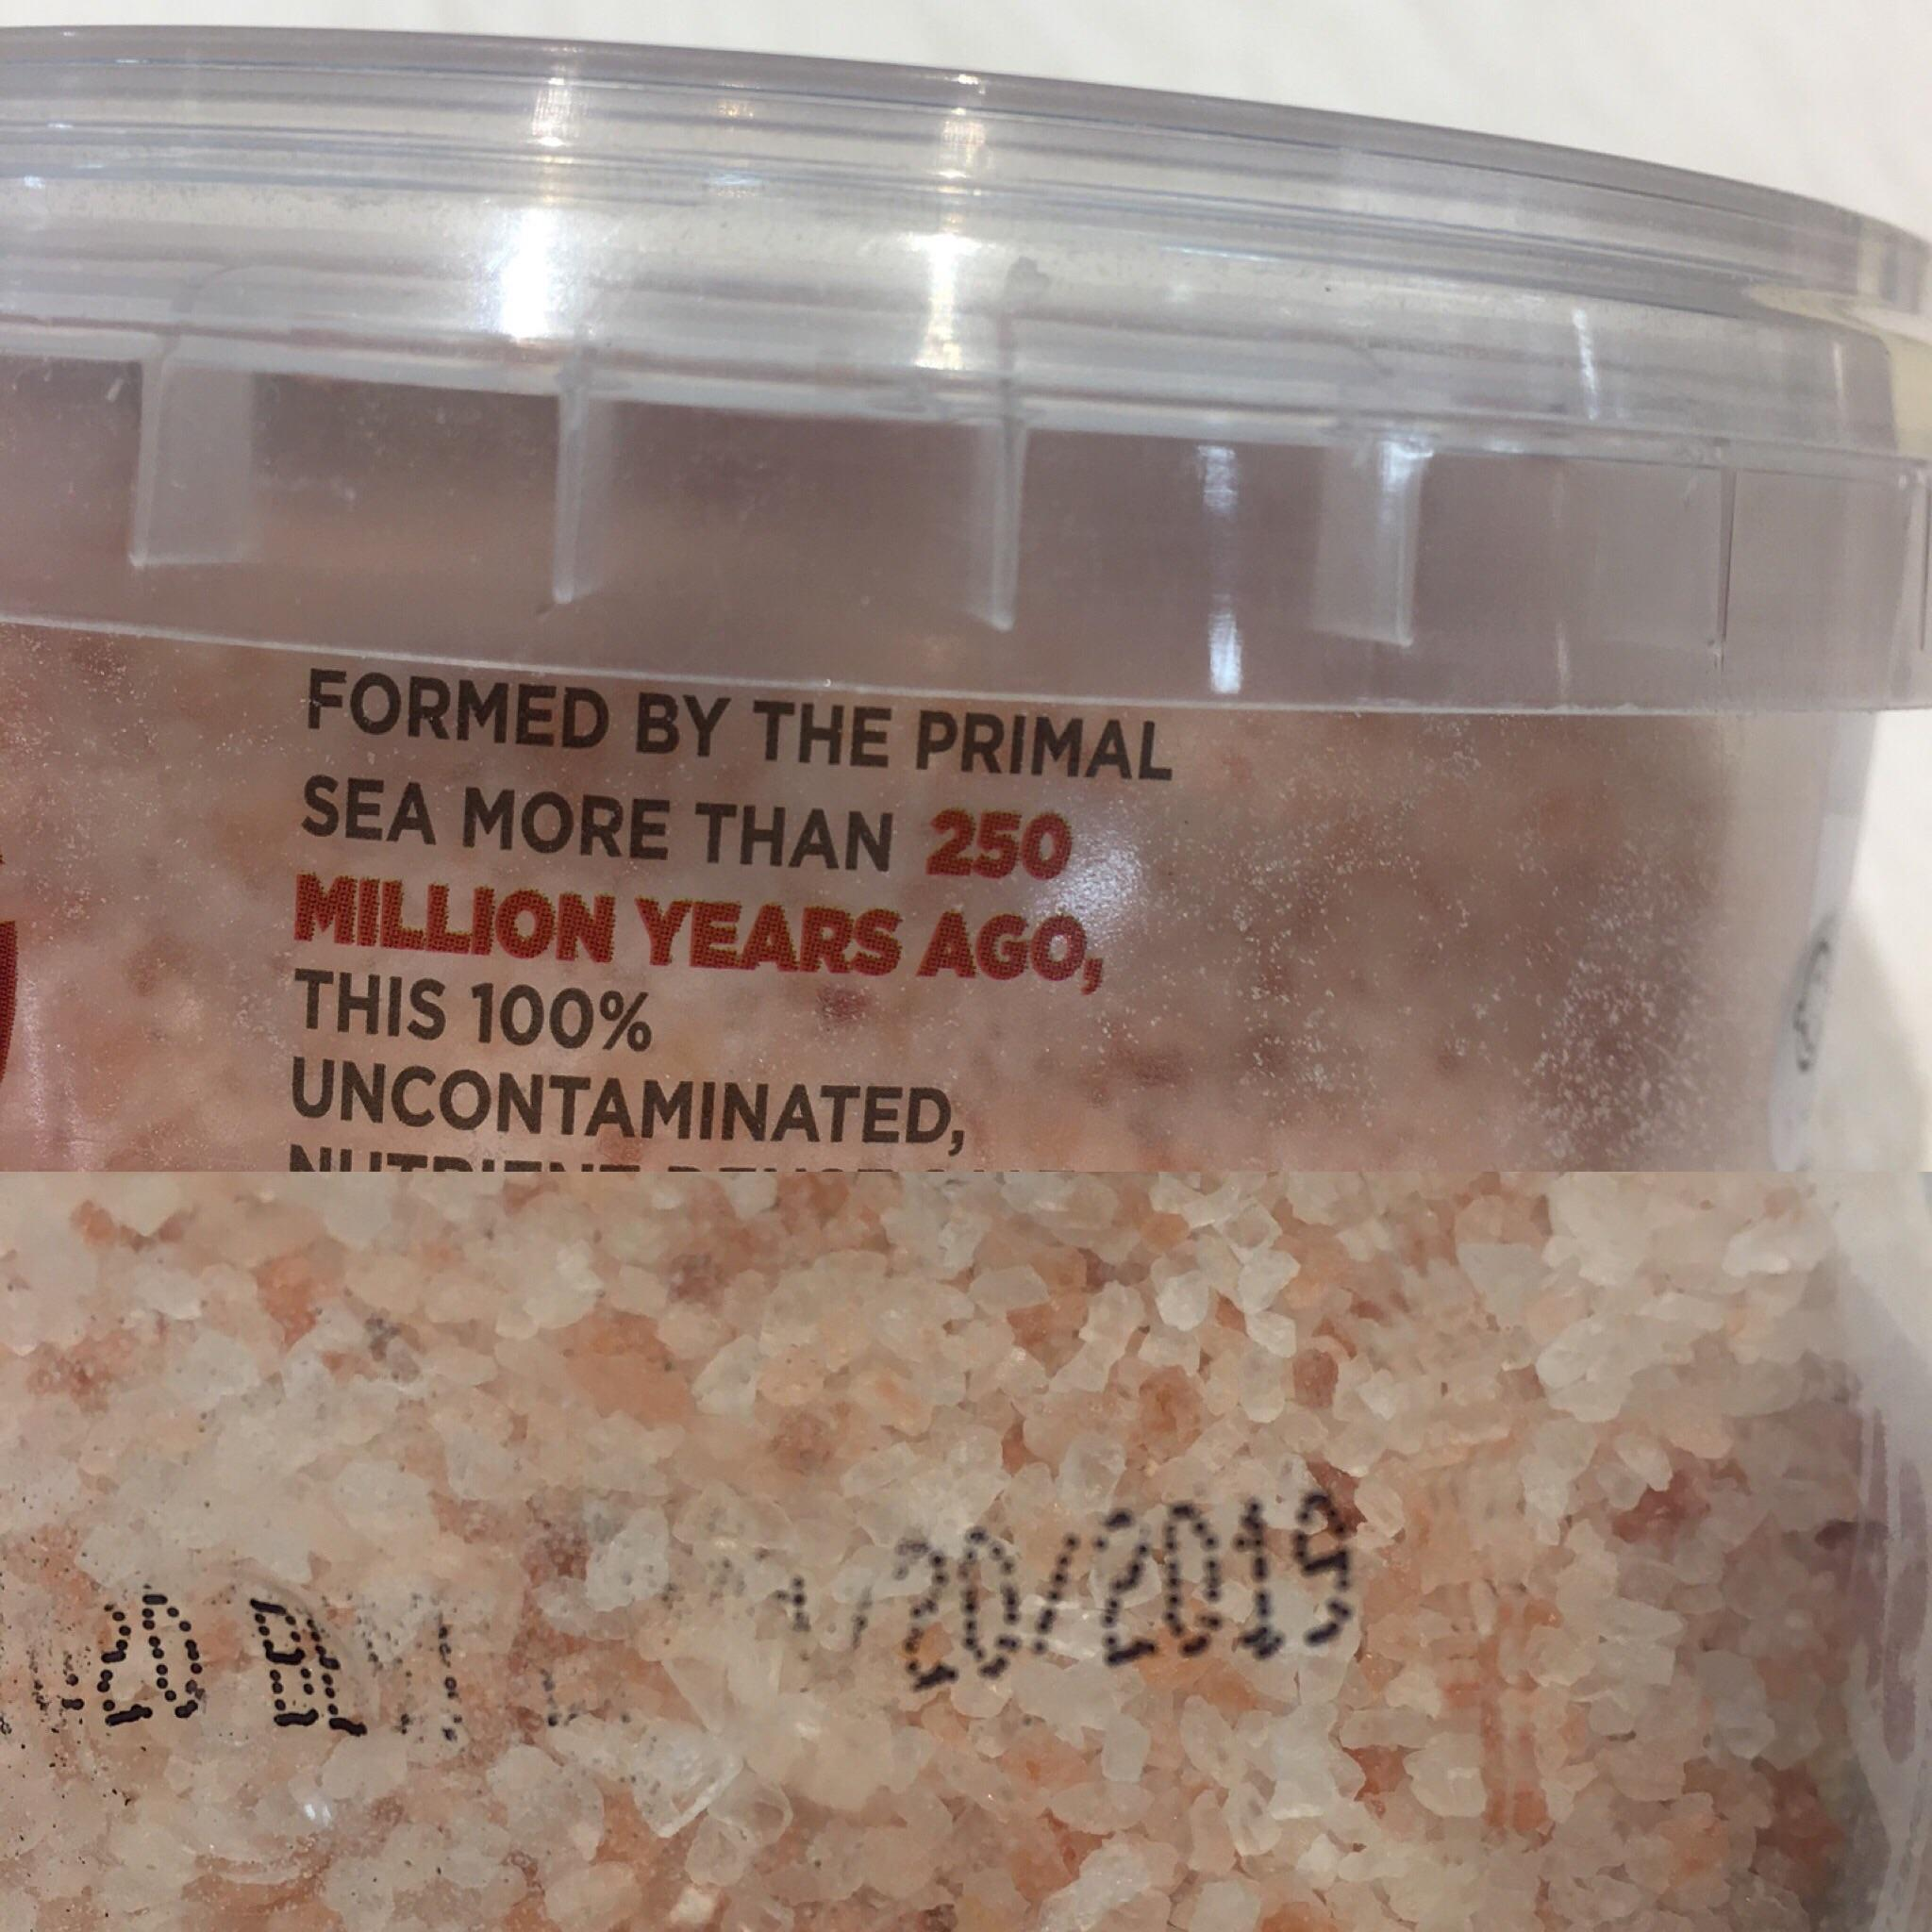
Disclosure, disclosure, disclosure!
What if this was a securities offering?
A metaphor:
Don't celebrate your sea salt for being "formed by the primal sea more than 250 million years ago" without also disclosing it expires next year.
Source: https://i.redd.it/3ent6tkrz4c01.jpg

Slide 7

Registration Requirements

Slide 8
Registration Exemption Options
?
How much money do you need?
Do want non-accredited investors?
Do you want to advertise?
Where (in which states) do you want to raise money?
How much money can you afford to spend?
?
?
?
?
?
?
?
?
?

Slide 9
What Terms are you Offering?
Common Options:
Equity
Interest on a debt
Convertible debt
Simple Agreement For Future Equity (SAFE)

Slide 10


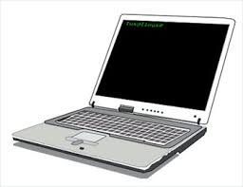

What is Securities Crowdfunding?
Utilizing the Internet to raise money from a “crowd” of investors to support your project.

Slide 11
What is Securities Crowdfunding?
Subject to federal and state securities laws!!
Caps on amount of $ raised
Caps on individual investments
Advertising Restrictions
Must be offered through a regulated portal
Must meet disclosure requirements
Best to work with an attorney and an accountant first

Slide 12
Regulation CF (federal exemption)
Sales in any state ok
Uto $1.07mm in 12 months
Must use FINRA-registered portal
Tiered investment limits based on income/net worth; (Limited) general advertising/solicitation allowed
Filing required with SEC

Slide 13
MNvest (Minnesota exemption)
MN residents only
up to $2mm in 12 months
Must use MN-registered portal
Non-accredited investors cannot invest more than $10,000
(Limited) general advertising/solicitation allowed
Filing required in MN

Slide 14
When is Crowdfunding Most Effective?
When you can B.Y.O.C.
Social/community component in addition to a financial component
Deal terms are clear and simple
Crowdfunding is half marketing, half fundraising: its spreading the word about why you are relevant and worthy of investment

Slide 15
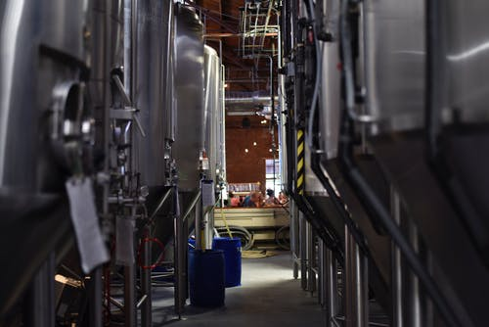
Securities Crowdfunding (Success Stories)
Rustech Brewing (MN): Raised $62,500
Tilion Brewing (MN): Raised $230,000

Slide 16

MN Community Solar is Thriving!
April 2019: MN Community Solar at 532 megawatts of operational capacity
Xcel data indicates that 84% of all subscribers in community solar gardens saving money
Source: https://ilsr.org/minnesotas-community-solar-program/

Slide 17
Solar Crowdfunding is Evolving!
2 Registered Portals:
Lake Superior Solar Finance (MNvest)
Silicon Prairie (MNvest & Reg CF)

Slide 18
How do I get started?
Draft business plan
Determine $ needed, and for what
Find an attorney and an accountant
With attorney and accountant input, decide on terms of investment and draft offering documents
Find a portal operator
File offering docs with regulators
Find investors!

Slide 19
Questions?
?
?
?
?
Brian Edstrom
612-584-3407
bedstrom@avisenlegal.com
?
?
?
?
?
?

